Slide 1

Pseudo-class; Pseudo-element

Slide 2
What are Pseudo-Class?
They are used to define a special state of an element
For example, style an element when a mouse move over it
For example, style visited vs unvisited link.

Slide 3

syntax

Slide 4
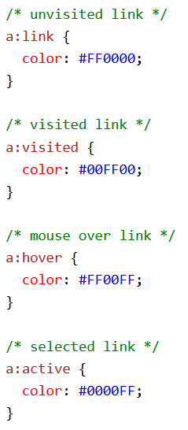
Anchor Pseudo-classes
Notes:
Note: a:hover MUST come after a:link and a:visited in the CSS definition in order to be effective! a:active MUST come after a:hover in the CSS definition in order to be effective! Pseudo-class names are not case-sensitive.

Slide 5

Note
Pseudo-classes can be combined with CSS classes.

Slide 6

Hover Pseudo-class

Slide 7
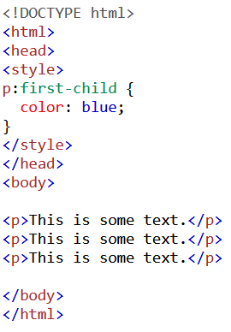
:first-child Pseudo-class
The :first-child pseudo-class matched a specified element that is the first child of another element.

Slide 8
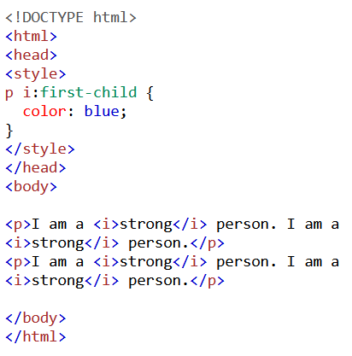
For example
This example demonstrates that the selector matches the first <i> elements in all <p> elements

Slide 9
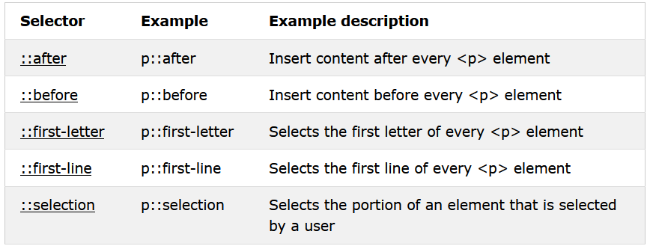
Summary of all CSS Pseudo Elements

Slide 10
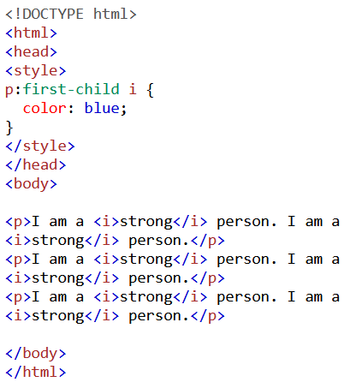
Another example
This example demonstrates that the selector only match all <i> element in <p> element that is part of the first child.

Slide 11
What are Pseudo-Elements
Pseudo-element is used to style specified parts of an element
For example, style only the first letter of an element
Or to insert content before or after the element

Slide 12

Syntax

Slide 13
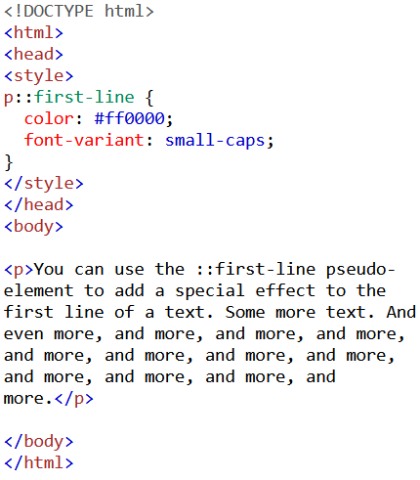
::first-line Pseudo-element
Notes:
You can change the window size and the first line still remains coloured!

Slide 14
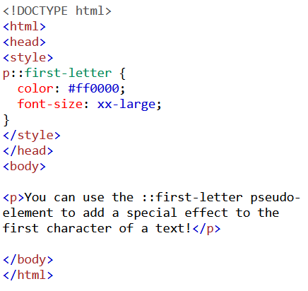
::first-letter Pseudo-element

Slide 15
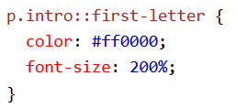
Note
Pseudo-elements can be combined with CSS classes.

Slide 16
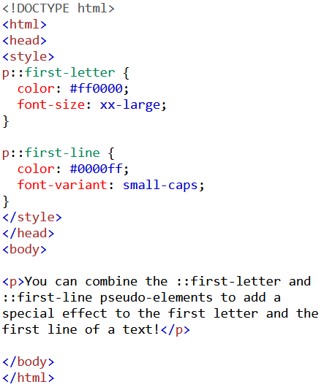
Multiple Pseudo-elements
Several Pseudo-elements can be combined

Slide 17
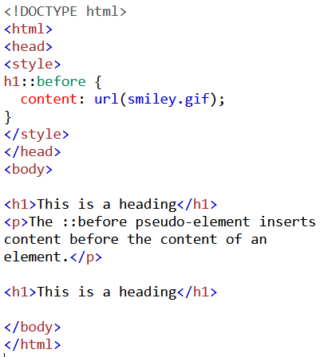
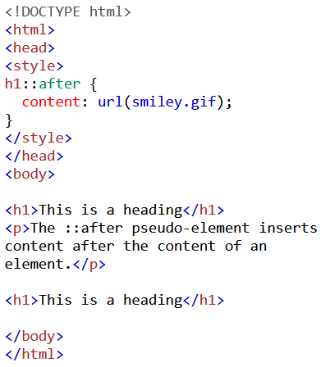
::before and ::after Pseudo-elements

Slide 18
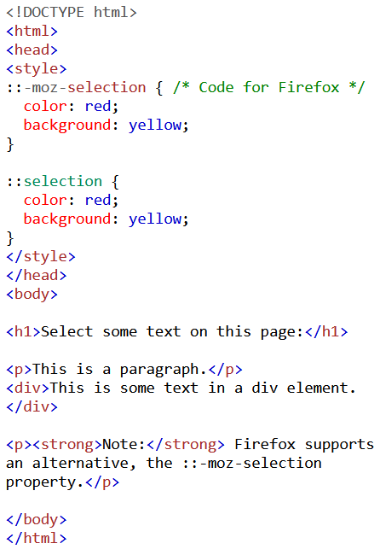
::selection Pseudo-element

Slide 19
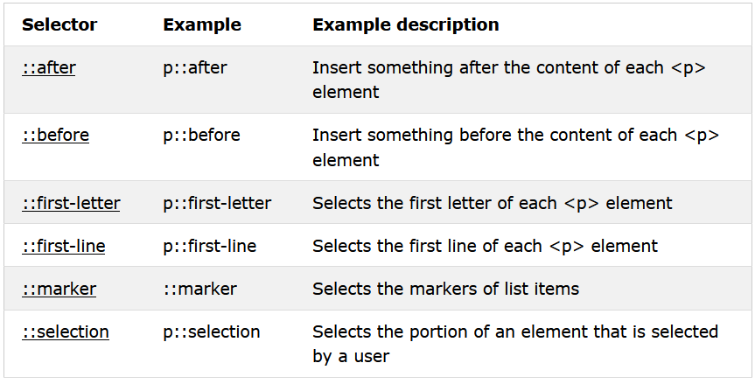
Summary of all CSS Pseudo-elements

Slide 20
Guided Example - Hover
Using Hover to make images change opacity when hovered.

